Slide 1

Linear Programming
Dr. Siddhaling Urolagin

Slide 2
Intro
If we can specify the objective as a linear function of certain variables,
and if we can specify the constraints on resources as equalities or inequalities on those variables,
then we have a linear programming problem.
A political problem
Suppose that you are a politician trying to win an election. Your district has three different types of areas—urban, suburban, and rural.
These areas have, respectively, 100,000, 200,000, and 50,000 registered voters

Slide 3
Although not all the registered voters actually go to the polls
You would like at least half the registered voters in each of the three regions to vote for you.
certain issues may be more effective in winning votes in certain places
Your primary issues are building more roads, gun control, farm subsidies, and a gasoline tax dedicated to improved public transit
you can estimate how many votes you win or lose from each population segment by spending $1,000 on advertising on each issue

Slide 4
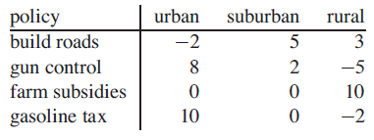
each entry indicates the number of thousands of either urban, suburban, or rural voters who would be won over by spending $1,000 on advertising in support of a particular issue
Negative entries denote votes that would be lost.
Your task is to figure out the minimum amount of money that you need to spend in order to win
50,000 urban votes, 100,000 suburban votes, and 25,000 rural votes.

Slide 5
For example, you could devote $20,000 of advertising to building roads, $0 to gun control, $4,000 to farm subsidies, and $9,000 to a gasoline tax.
In this case, you would win thousand urban votes, thousand suburban votes, and
82 thousand rural votes. You would win.

Slide 6
We introduce 4 variables
x1 is the number of thousands of dollars spent on advertising on building roads,
x2 is the number of thousands of dollars spent on advertising on gun control
x3 is the number of thousands of dollars spent on advertising on farm subsidies
x4 is the number of thousands of dollars spent on advertising on a gasoline tax

Slide 7



We can write the requirement that we win at least 50,000 urban votes as
we win at least 100,000 suburban votes and 25,000 rural votes as
Any setting of the variables x1; x2; x3; x4 that satisfies inequalities yields a strategy that wins a sufficient number of each type of vote

Slide 8


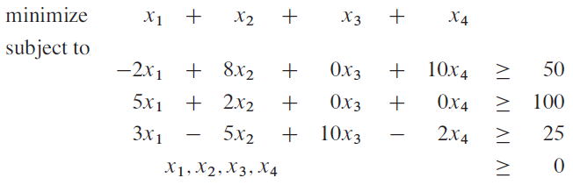
you want to minimize the expression
we require that
Combining inequalities with the objective of minimizing we obtain what is known as a “linear program. We format this problem as

Slide 9


General linear programs
We wish to optimize a linear function subject to a set of linear inequalities
Given a set of real numbers a1, a2,…,an and a set of variables x1, x2,…,xn, we define a linear function f on those variables by
If b is a real number and f is a linear function, then the equation
is a linear equality and the inequalities are linear inequalities.

Slide 10
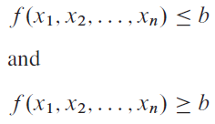
a linear-programming problem is the problem of either minimizing or maximizing a linear function subject to a finite set of linear constraints.

Slide 11
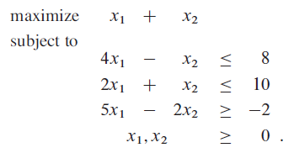
An overview of linear programming
A linear program in standard form is the maximization of a linear function subject to linear inequalities
Maximizing a linear function on n variables subject to a set of m linear inequalities.
A feasible solution any setting of the variables x1 and x2 that satisfies constraints

Slide 12
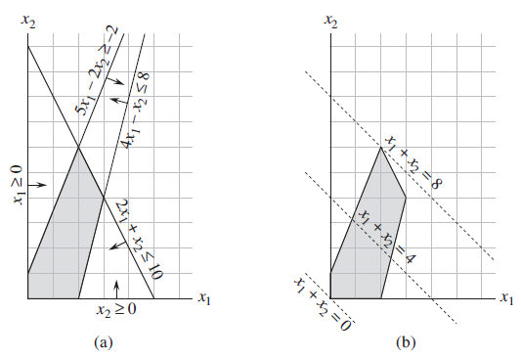
Graph Representation
(x1, x2) Cartesian coordinate system
Each constraint is represented by a line and a direction
set of feasible solutions (shaded in the figure) forms a convex region1
The function we wish to maximize the objective function

Slide 13
We call this convex region the feasible region and the function we wish to maximize the objective function
we call the value of the objective function at a particular point the objective value
We could then identify a point that has the maximum objective value as an optimal solution
The feasible region contains an infinite number of points,
and so we need to determine an efficient way to find a point that achieves
the maximum objective value without explicitly evaluating the objective function at every point in the feasible region.

Slide 14
The set of points for which x1+x2= z for any z is a line with a slope of --1.
If we plot x1+x2=0, we obtain the line with slope -1 through the origin
The intersection of this line and the feasible region is the set of feasible solutions that have an objective value of 0.
In this case, that intersection of the line with the feasible region is the single point (0,0)

Slide 15
For any z the intersection of the line x1+x2=z and the feasible region is the set of feasible solutions that have objective value z.
Figure shows the lines x1 + x2= 0, x1 + x2 = 4, and x1+ x2= 8
Any point at which this occurs is an optimal
solution to the linear program, which in this case is
the point x1 = 2 and x2 = 6 with objective value 8

Slide 16
An optimal solution to the linear program occurs at a vertex of the feasible region
If the intersection is a single vertex, then there is just one optimal solution
If the intersection is a line segment, every point on that line segment must have the same objective value;
In particular, both endpoints of the line segment are optimal solutions
If we have three variables, then each constraint corresponds to a half-space in three-dimensional space
The set of points for which the objective function obtains a given value Z is now a plane

Slide 17
If all coefficients of the objective function are nonnegative, and if the origin is a feasible solution to the linear program,
then as we move this plane away from the origin, in a direction normal to the objective function, we find points of increasing objective value.
if we have n variables, each constraint defines a half-space in n-dimensional space.
We call the feasible region formed by the intersection of these half-spaces a simplex
The simplex algorithm takes as input a linear program and returns an optimal solution.
It starts at some vertex of the simplex and performs a sequence of iterations.
In each iteration, it moves along an edge of the simplex from a current vertex to a neighboring vertex whose objective value is no smaller than that of the current vertex

Slide 18
The simplex algorithm terminates when it reaches a local maximum,
which is a vertex from which all neighboring vertices have a smaller objective value
we shall use a concept called “duality” to show that the solution returned by the simplex algorithm is indeed optimal.

Slide 19
Applications of linear programming
An airline wishes to schedule its flight crews.
The Federal Aviation Administration imposes many constraints, such as limiting the number of consecutive hours
that each crew member can work and insisting that a particular crew work only on one model of aircraft during each month.
The airline wants to schedule crews on all of its flights using as few crew members as possible.

Slide 20
An oil company wants to decide where to drill for oil.
Siting a drill at a particular location has an associated cost and, based on geological surveys,
an expected payoff of some number of barrels of oil.
The company has a limited budget for locating new drills and wants to maximize the amount of oil it expects to find, given this budget.

Slide 21



Standard and slack forms
In standard form, we are given n real numbers
m real numbers
and mn real numbers
We wish to find n real numbers
Such that

Slide 22

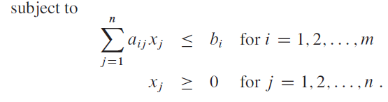
Objective function
Constraints

Slide 23




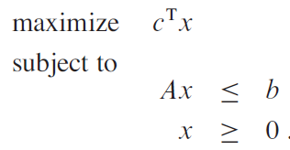
We create an mXn matrix
standard form by a tuple (A, b, c)

Slide 24

that satisfies all the constraints a feasible solution
If a linear program has some feasible solutions but does not have a finite optimal objective value, we say that the linear program is unbounded.

Slide 25
Converting linear programs into standard form
It is always possible to convert a linear program, given as minimizing or maximizing
A linear function subject to linear constraints, into standard form
Four possible reasons not in standard form
1. The objective function might be a minimization rather than a maximization.
2. There might be variables without nonnegativity constraints.
3. There might be equality constraints, which have an equal sign rather than a
less-than-or-equal-to sign.
4. There might be inequality constraints, but instead of having a less-than-or equal-to sign, they have a greater-than-or-equal-to sign.

Slide 26
Converting one linear program L into another linear program L’ equivalent
If for each feasible solution x̄ to L with objective value z, there is a corresponding feasible solution x̄’ to L’ with objective value z and vice versa
To convert a minimization linear program L into an equivalent maximization linear program L’
We simply negate the coefficients in the objective function.

Slide 27
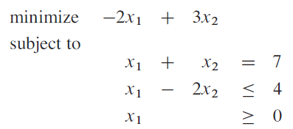
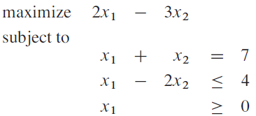
Example
we negate the coefficients of the objective function

Slide 28


Convert a linear program in which some of the variables do not have nonnegativity constraints into one in which each variable has a nonnegativity constraint.
Suppose that some variable x_{j} does not have a nonnegativity constraint.
replace each occurrence of x_{j} by
add the nonnegativity constraints

Slide 29



If the objective function has a term c_{j}x_{j} , we replace it by
If constraint i has a term a_{ij}x_{j}, we replace it by
Any feasible solution x̂ to the new linear program corresponds to a feasible solution x̄ to the original linear program with

Slide 30


Also, any feasible x̄ solution to the original linear program corresponds to a feasible solution x̂ to the new linear program with
We apply this conversion scheme to each variable that does not have a nonnegativity constraint to yield an equivalent linear program in which all variables have nonnegativity constraints

Slide 31
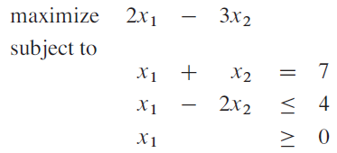

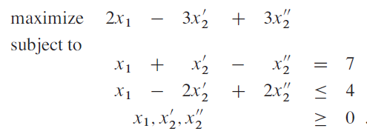
Example
We want to ensure that each variable has a corresponding nonnegativity constraint. Variable x1 has such a constraint, but variable x2 does not.
In below example
Replace x2
Modify the linear program to obtain

Slide 32
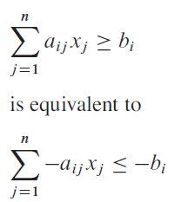
We convert equality constraints into inequality constraints.
Suppose that a linear program has an equality constraint.
Since x = y if and only if both x >= y and x <= y, we can replace this equality constraint by the pair of inequality constraints
We can convert the greater-than-or-equal-to constraints to less-than-or equal-to constraints by multiplying these constraints through by -1.

Slide 33
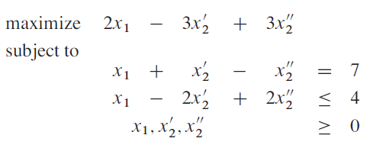
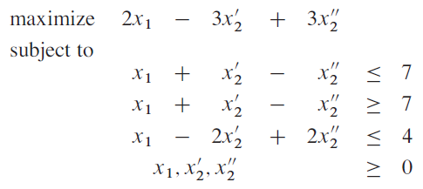
Example
We replace the equality in constraint by two inequalities, obtaining

Slide 34

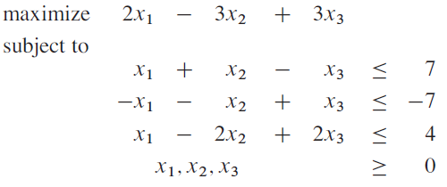
We negate constraint and replace

Slide 35

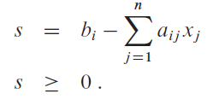
Converting linear programs into slack form
we shall convert it into a form in which the nonnegativity constraints are the only inequality constraints, and the remaining constraints are equalities, let given inequality constraint
We introduce a new variable s and rewrite inequality as the two constraints
We call s a slack variable because it measures the slack, or difference, between the left-hand and right-hand sides of equation

Slide 36


When converting from standard to slack form, we shall use x_{n+i} (instead of s) to denote the slack variable associated with the i^{th} inequality.
The i^{th} constraint is therefore
Nonnegativity constraints

Slide 37
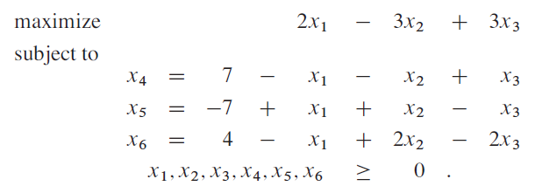
Example
we introduce slack variables x4, x5, and x6, and obtain the following equations
In this linear program, all the constraints except for the nonnegativity constraints are equalities, and each variable is subject to a nonnegativity constraint
We call the variables on the left-hand side of the equalities basic variables and those on the right-hand side nonbasic variables

Slide 38
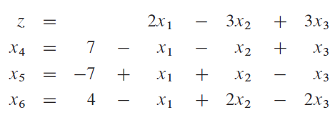
We shall also use the variable Z to denote the value of the objective function. We call the resulting format slack form

Slide 39

We use N to denote the set of indices of the nonbasic variables and B to denote the set of indices of the basic variables.
We always have that
As in standard form, we use b_{i} , c_{j}, and a_{ij} to denote constant terms and coefficients.
We also use v to denote an optional constant term in the objective function.

Slide 40
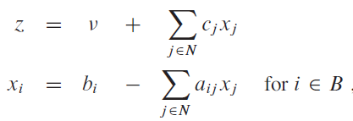
Thus we can concisely define a slack form by a tuple (N, B, A, b, c. v), denoting the slack form
In which all variables x are constrained to be nonnegative

Slide 41
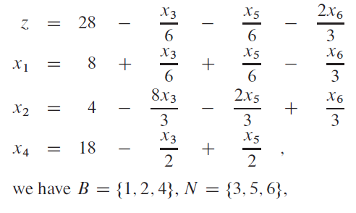
Example

Slide 42
